Slide 1
Bond Basics
Dr. Craig Ruff
Department of Finance
J. Mack Robinson College of Business
Georgia State University
© 2014 Craig Ruff

Slide 2
Primary versus Secondary Markets
Primary Market – The market for securities (stocks and bonds) when the securities are first issued. For instance, an ‘IPO’ is handled in the primary market.
Secondary Market – The market trading securities after they have been issued. The New York Stock Exchange is an example of a secondary market.
“Investment Banks
Investment banks (capital market banks) underwrite debt and equity, assist company deals (advisory services, underwriting and advisory fees), and restructure debt into structured finance products.”

Slide 3
Primary versus Secondary Markets
Primary Market – The market for securities (stocks and bonds) when the securities are first issued. For instance, an ‘IPO’ is handled in the primary market.
Secondary Market – The market trading securities after they have been issued. The New York Stock Exchange is an example of a secondary market.
Here: The issuer (the corporation or governmental body) of the security raises money (capital).
Here: No money flows to the corporation or government…just transferring money and claims between investors.

Slide 4
Primary versus Secondary Markets
Friday, May 18, 2012
Primary Market – The market for securities (stocks and bonds) when the securities are first issued. For instance, an ‘IPO’ is handled in the primary market.
Secondary Market – The market trading securities after they have been issued. The New York Stock Exchange is an example of a secondary market.

Slide 5
Debt (Bonds?) vs. Equity (Common Stock?)
Corporate Balance Sheet
Borrowed capital that the company promises to repay (plus interest).
Assets
Debt
Preferred Stock
Common Stock
5
Notes:
5

Slide 6
Debt (Bonds?) vs. Equity (Common Stock?)
There is confusion over what is meant by debt…
Corporate Balance Sheet
Corporate Balance Sheet
Assets
Debt
Assets
Accounts Payable and Accrued Liabilities
Equity
Bank Loans and Bonds
Equity
We will generally assume that when dealing with ratios (like the debt ratio), then we mean the broader definition of debt (accounts payable plus accrued liabilities plus bank loans plus bonds, etc.)
We will generally assume that when dealing with capital budgeting, debt means just financing-specific obligations, like bank loans and bonds. Indeed, with capital budgeting, we generally assume that ‘debt’ is just bonds.
6
Notes:
6

Slide 7
Debt (Bonds?) vs. Equity (Common Stock?)
Corporate Balance Sheet
Hybrid - Not really equity or debt
Different structures
Often gets a set periodic payment
Paid before equity but after bonds
Often no corporate control
Assets
Debt
Preferred Stock
Common Stock
7
Notes:
7

Slide 8
Debt (Bonds?) vs. Equity (Common Stock?)
Corporate Balance Sheet
Assets
Debt
Typically, the ownership stake – this represents the wealth of the owners
Invested capital
No promises about future cash flows, except the firm’s stockholders own the residual claim on the firm (what is left over after debt holders and preferred stock holders have been paid)
Preferred Stock
Common Stock
8
Notes:
8

Slide 9
Debt (Bonds?) vs. Equity (Common Stock?)
Corporate Balance Sheet
Corporate Balance Sheet
Assets
Debt
Assets
Debt
Equity
Preferred Stock
Common Stock
As a rule, here, if you just see debt and equity, assume that the equity is common stock (and there is no preferred stock).
9
Notes:
9

Slide 10
Bonds

Slide 11
Bonds
Obviously, there are other bond issuers (borrowers) than just businesses.
Corporate Balance Sheet
Government Balance Sheet
Assets
Debt
Debt
Equity

Slide 12
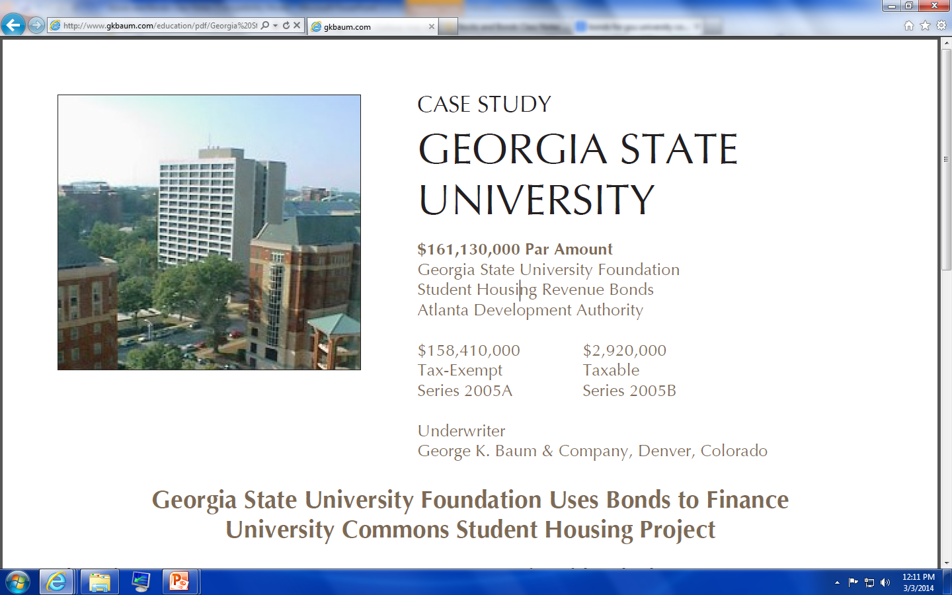
Bonds

Slide 13
Bonds
Upfront $$$
room
GSU Students Pay Rent
GSU Builds Dorm and Rents Rooms to Students
Bond Investors
Rent $$$
Interest and Principal $$$

Slide 14
Bond Terminology
Par (or, Face) Value – amount the bond pays off at maturity
Coupon Interest Rate – coupon rate times the face value determines the periodic coupon payments
Coupon Payment – coupon rate times face value equals coupon payment (cut in half if the bond pays every six months)
Yield – typically, this is the bond’s yield-to-maturity; the bond’s “market rate” or “market yield”
Maturity Date – date on which the par value is paid (and the final coupon payment is also made)
Required return, market rate, discount rate

Slide 15
Bond Terminology
Consider a bond with a face value of $1,000, a coupon rate of 10%, a maturity of ten years, and it makes annual coupon payments…

Slide 16
Bond Terminology
Consider a bond with a face value of $1,000, a coupon rate of 8%, a maturity of ten years, and it makes semi-annual coupon payments…

Slide 17
Bond Terminology
The bond area is sometimes called “fixed income”:
Coupon
Coupon
Coupon
Coupon
Coupon
Coupon
Coupon
Coupon
Coupon
+Face Value
But, often the cash flows are not truly “fixed”:
-Embedded Options (like callable bonds or mortgage-backed bonds)
-Floating Rate Bonds

Slide 18
Bond Terminology
Basis Point: 1/100 of 1%
If a rate changed from, say, 4.05% to 4.07%, then it increased two basis points.
If a rate changed from, say, 3.98% to 5.98%, then it increased two hundred basis points.
If you can pick up 3 basis points on $2 billion ➔ $600,000/year

Slide 19
End

